Slide 1
Leading Score Case Study
Group Members:
Naga Deepika Panchagnula
Devang Chudasama
Noel Darsi

Slide 2
Problem Statement:
An education company named X Education sells online courses to industry professionals. On any given day, many professionals who are interested in the courses land on their website and browse for courses.
The company markets its courses on several websites and search engines like Google. Once these people land on the website, they might browse the courses or fill up a form for the course or watch some videos. When these people fill up a form providing their email address or phone number, they are classified to be a lead. Moreover, the company also gets leads through past referrals. Once these leads are acquired, employees from the sales team start making calls, writing emails, etc. Through this process, some of the leads get converted while most do not. The typical lead conversion rate at X education is around 30%.
Now, although X Education gets a lot of leads, its lead conversion rate is very poor. For example, if, say, they acquire 100 leads in a day, only about 30 of them are converted. To make this process more efficient, the company wishes to identify the most potential leads, also known as ‘Hot Leads’. If they successfully identify this set of leads, the lead conversion rate should go up as the sales team will now be focusing more on communicating with the potential leads rather than making calls to everyone.

Slide 3
Goals of the Case Study:
There are quite a few goals for this case study:
Build a logistic regression model to assign a lead score between 0 and 100 to each of the leads which can be used by the company to target potential leads.
A higher score would mean that the lead is hot, i.e. is most likely to convert whereas a lower score would mean that the lead is cold and will mostly not get converted.
There are some more problems presented by the company which your model should be able to adjust to if the company's requirement changes in the future so you will need to handle these as well.
From case study itself it’s clearly mentioned it is classification problem so we use Logistic Regression for this.

Slide 4
Solution:
Data Cleaning and Data manipulation:
1.Check and handle duplicates.
2.Check and handle NA values with missing values
3.Drop columns if it contains large amount of missing values that are not used for analysis.
4.Imputations of the values
5.Check and handle outliers.
EDA:
Univariate Data Analysis.
Bi-variate Data Analysis.
Feature Scaling and dummy variables.
Using Logistic Regression used to predict the model.
Validation of the model.
Model Presentation.
Conclusions.

Slide 5
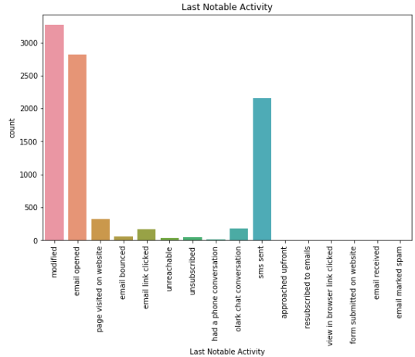
Data Cleaning and Manipulation:
Leads Dataframe consists 9240 records and 37 columns.
Single valued features such as Magazine, Receive More Updates About Our Courses, I agree to pay the amount through cheque.
We can drop the features like Get updates on DM Content, Update me on Supply Chain Content.
Remove the ‘Prospect Id’ and ‘lead number’ which is not necessary for the analysis.
Dropping the columns having more than 35% as missing values.
EDA: For numerical and categorical variables.

Slide 6
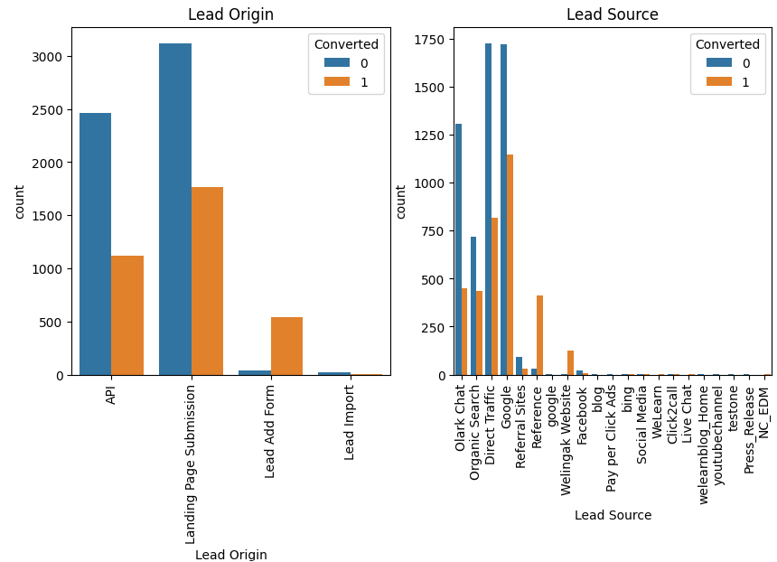
For Categorical Variables:

Slide 7
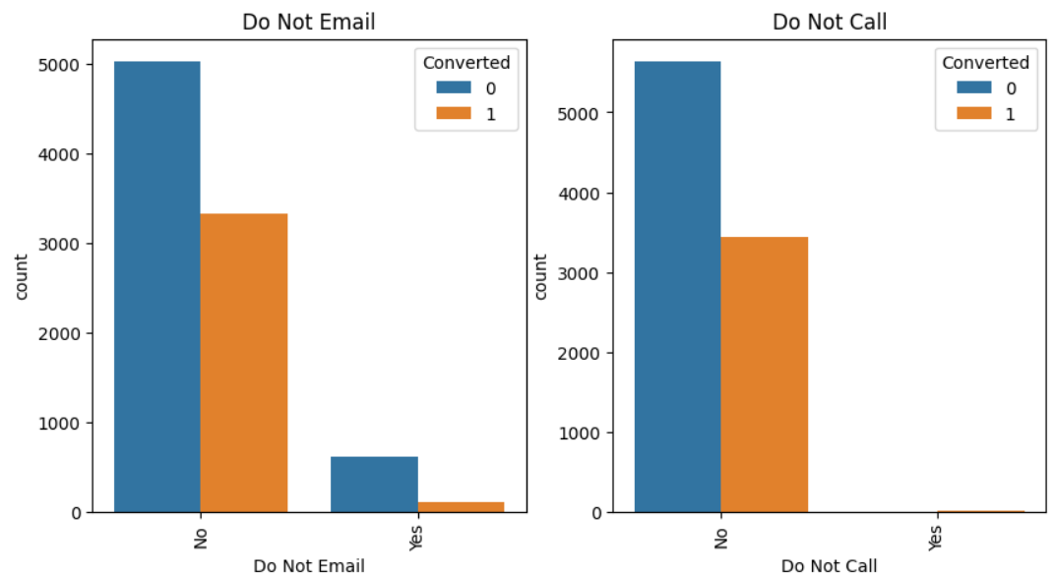
For Categorical Variables:

Slide 8
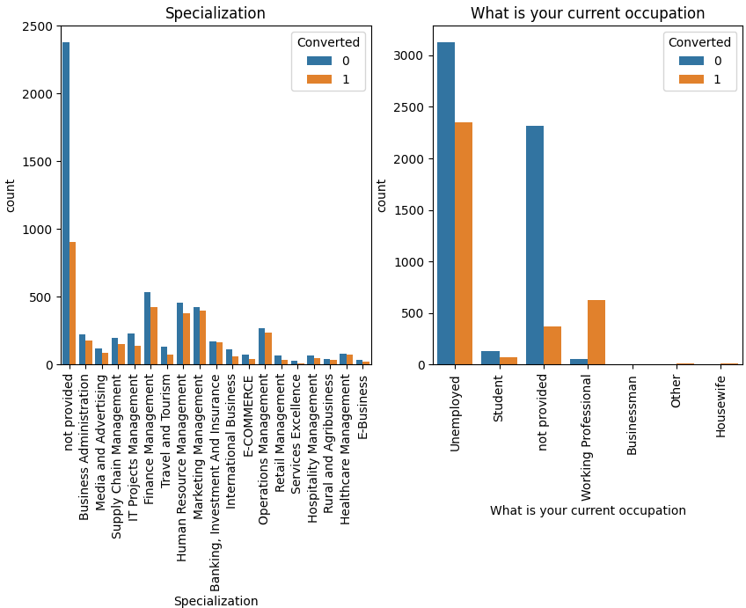
For Categorical Variables:

Slide 9
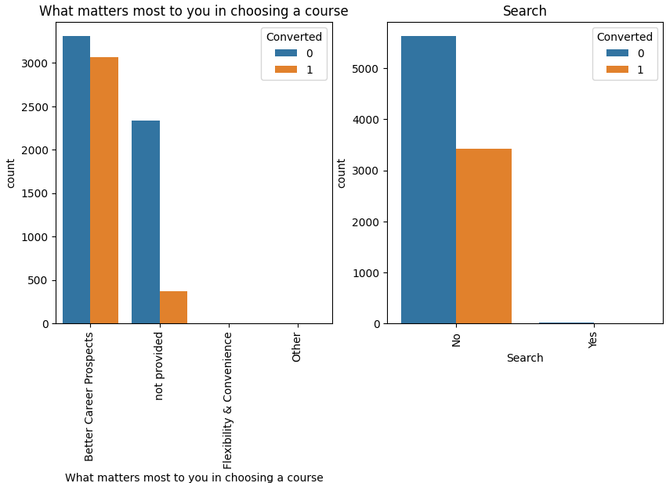
For Categorical Variables:

Slide 10
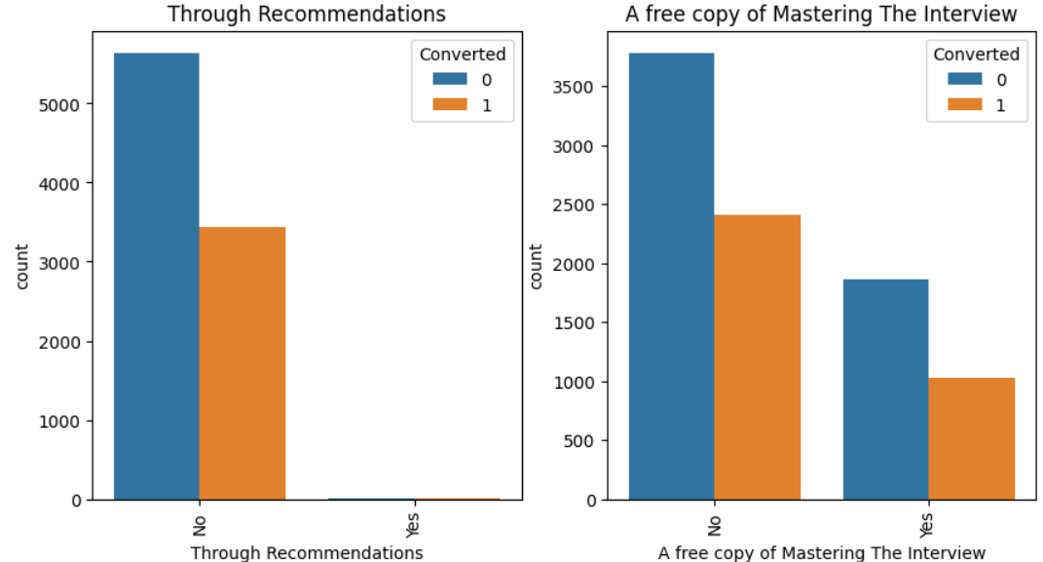
For Categorical Variables:

Slide 11
Data Conversion and Dummy variables:
Numerical variables are normalized
Dummy variables are created for object type variables.
Total rows for analysis are 9074 rows and 101 columns.
After dropping the columns in the dataframe it’s 9074 rows and 82 columns.

Slide 12
Model Building:
Splitting the data into Train and test sets.
The step we follow in the regression is we split the train and test ratio as 70:30.
we use RFE for Feature selection.
We will take 15 features to run RFE.
Building a model by dropping the variables whose p-value is greater than 0.05 and vif value is greater than 5.
Predictions on the test data.
Overall accuracy is 81%.

Slide 13
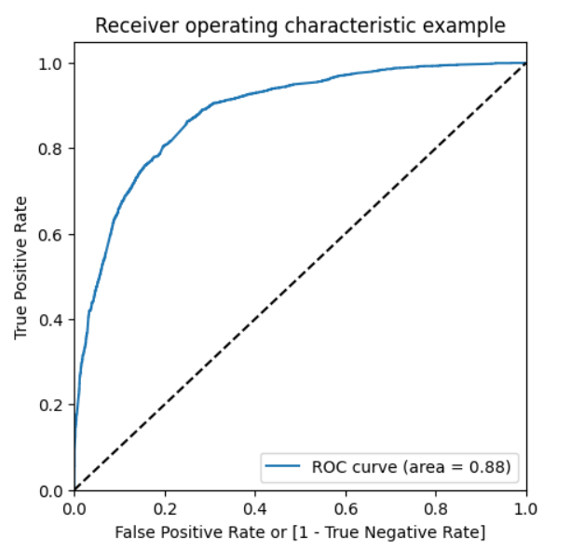
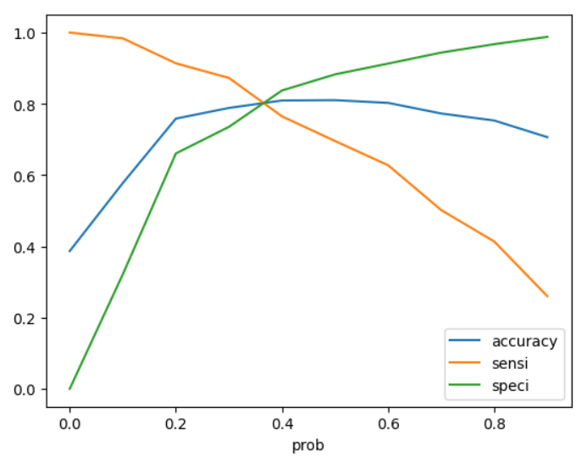
ROC & AUC :

Slide 14
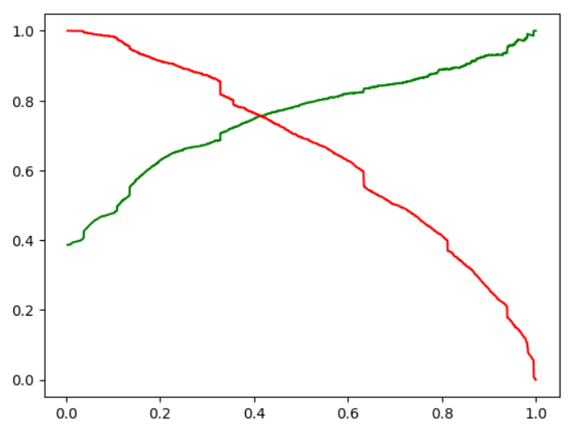
Cut-Off:
From the above cut off as 0.37 we have accuracy, sensitivity and specificity of around 81%.
Precision and Recall:
we have Precision around 75% and Recall around 76% and cut off as 0.41.

Slide 15
Conclusion:
The variables that are the most found in the potential buyers for the above case study are:
Total time spent on the website.
Total number of visits.
Lead sources are: Google and Wellingak website.
Lead Activities are SMS and the Chat conversations.
The other one when the current occupation are:
Working Professionals
Student
Unemployed
Others.
From the above the X educational company increases the potential buyers to but their courses.

Slide 16
Thank You

